Slide 1
Blending Old School Wisdom with New School Technologies

Slide 2
History of Technology
1930- overhead projector
1940- ballpoint pen
1950- headphones
1951- video tapes
1959- photocopier
1972- handheld calculator
1980’s- everyday-use computers were introduced
1981- first portable computers
1985- Toshiba released the first mass-market consumer laptop
1990- World Wide Web was given life
1993- commercial use of the internet
2009- 97% of classrooms had 1 or more computers
Smart boards, Elmos, Promethean Boards, Clickers…
Notes:
1930- overhead projector- how many of you still have them in a back closet of your library at school? These things are almost 100 years old!
1940- ballpoint pen- old but still relevant, its changing and evolving but it’s still has a purpose
1950- headphones
1951- videotapes- Break one of these out in a K-2 classroom and it’s very likely that they don’t know what it is.
1959- photocopier
1972- handheld calculator
1980’s- everyday-use computers were introduced
1981- first portable computers
1985- Toshiba released the first mass-market consumer laptop- this changed the world and they way we work. No longer were we tied to a set location, we could work from almost anywhere.
1990- World Wide Web was given life
1993- commercial use of the internet- this really changed the way we work, lots of employers allow their employees to work from home.
2009- 97% of classrooms had 1 or more computers – How many of you have five or more computers in your classrooms today?
Smartboards, Elmos, promethan boards, clickers….
The face of education has always been changing and advancing. The difference is in the pace of which these things are happening.

Slide 3
Slide Title
Make Effective Presentations
Using Awesome Backgrounds
Engage your Audience
Capture Audience Attention
Notes:
With the evolution of technology, educational capabilities are growing and changing every day. As technology advances, our abilities grow by leaps and bounds, and without the knowledge of these changes and capabilities, an instructor has a good chance of being left behind.

Slide 4
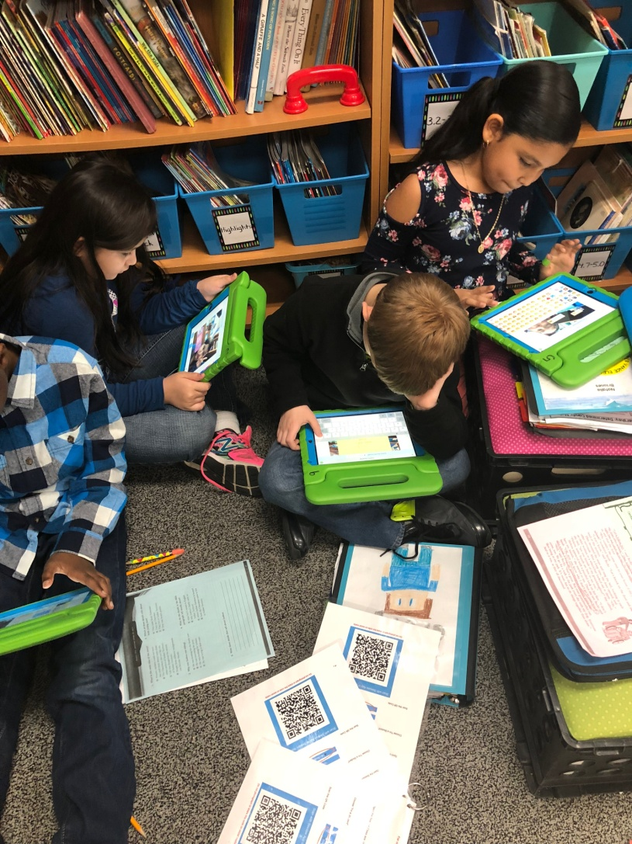
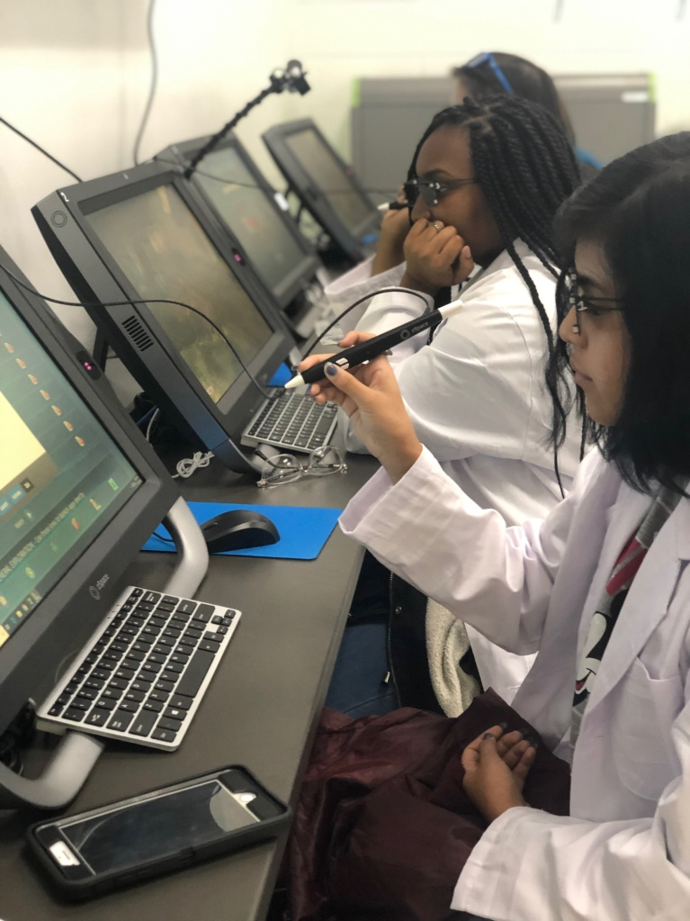
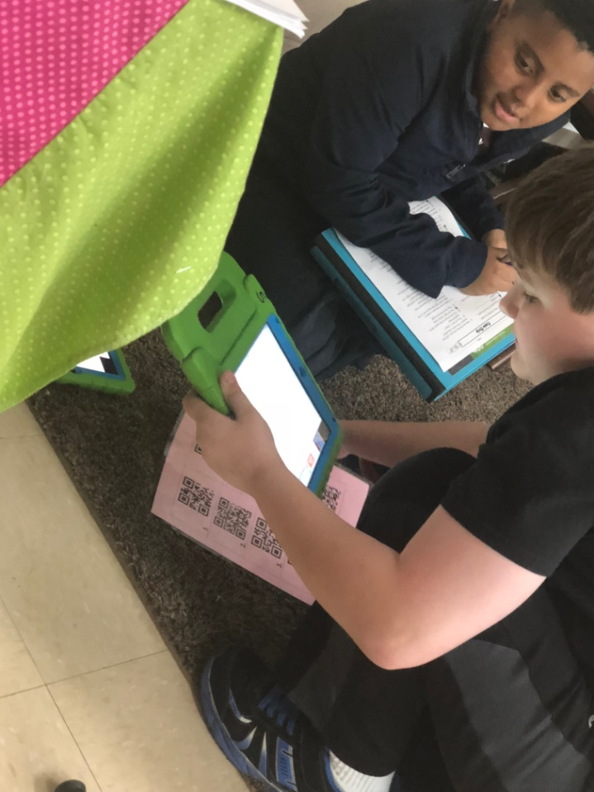
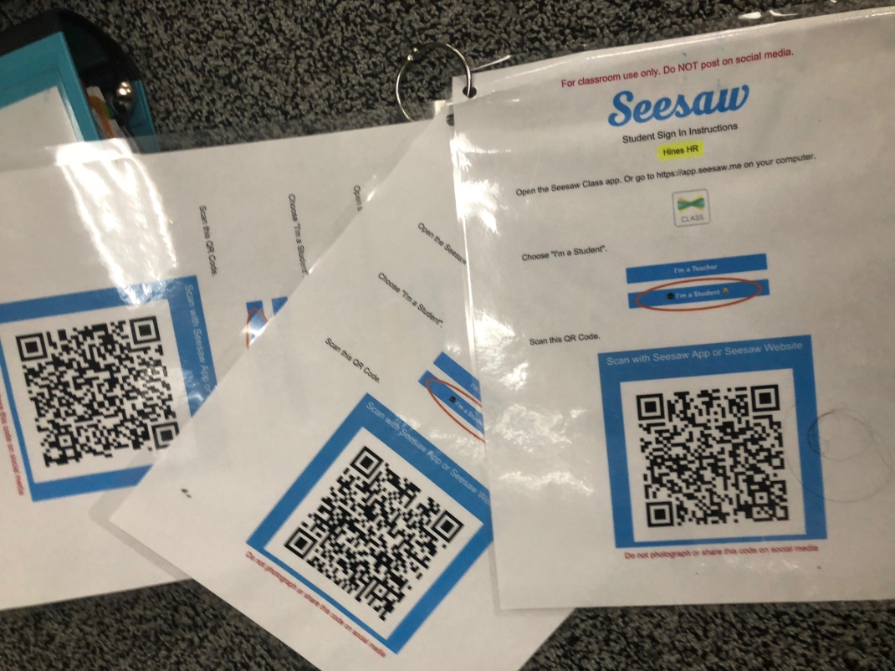
Classrooms of Tomorrow
Notes:
So where is the balance between the image we saw before and the one presented here.
Our country has shown great growth in the past 150 years as education has evolved. We can all think back on one teacher during our educational endeavors who has been a highly effective “old” school educator. Do we leave all the old stuff behind to make room for the blended learning? We have to blend the old school wisdoms that work with new school technologies to better meet the needs of our learners. Long gone are days of students sitting in individualized rows and everyone is working on the same thing at the same time. The images above are a little chaotic, I like to call it “organized chaos” as meaningful learning is taking place and deep discussions are occuring.

Slide 5
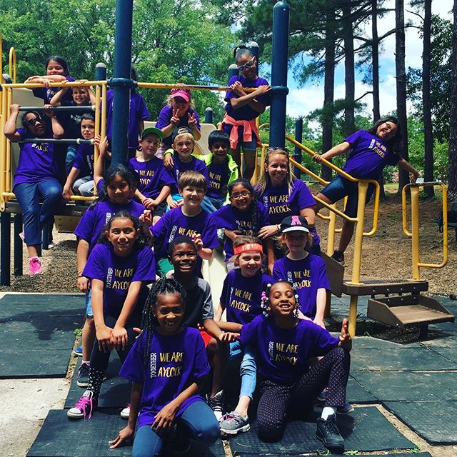
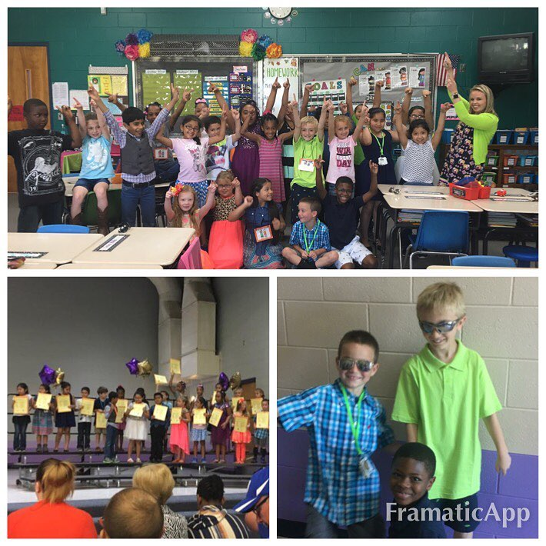
Notes:
So where do I fit into all of this?
I have the pictures of the class that transformed ME as an educator the class that taught me what authentic learning looked like and what blended learning really was. You see I had been using technology before with my clickers which eventually became Plickers and I used my Elmo and smart board ALL of the time so I thought I was accomplished on technology, you know those little boxes we all have to get checked as educators each year. But you see this group was DIFFERENT! They came to class asking about, breathing, and demanding more technology. So I knew that I had to change what I was doing, I had to change what I had been doing for years (without losing what I had been doing, because it worked) to meet these children where they were. So I set out to give them what they wanted and needed!
The first thing I tried with them was seesaw, I didn’t know everything about the program, didn’t know anyone who had used the program, but I took a leap of faith and gave it a try. The other thing I did was I told my students I didn’t know much about the app, that I wouldn’t have all of the answers but we would learn together. If something didn’t work we would try our best to fix it/ figure it out and that we would be learning together. I told them we would plearn to familiarize ourselves with the app and how to use it, we would share with our friends the new things we learned… The looks on their faces when I explained this was priceless, they were so excited to try something new and different and they quite honestly couldn’t believe that I didn’t know what I was doing… and so we learned together. We went from answering a simple question about ourselves to recording readings and preparing questions for our peers to answer. We got to the point that peer feedback was more sought after than my feedback and eventually we invited the parents to join our digital classroom so they too could see all of the great things that were happening and provide comments and support for out scholars. It was a different way of learning and communicating but it was similar to what I had done in the past, it was just done in a different way.

Slide 6
Transitioning from Traditional to Modern Learning Environments
Vance County Schools

Slide 7
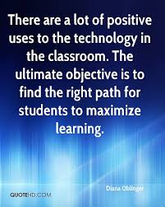
Slide Title

